Slide 1
Shiny tutorial
Alex Fulk
Notes:
Hello everyone, my name is alex fulk and today I’ll be starting a tutorial that will explain shiny applications and how to utilize them to make research more interactive.

Slide 2
Some Basics
What is a shiny application?
What does shiny have to do with R?
https://www.tutorialspoint.com/r/index.htm
https://shiny.rstudio.com/gallery/#user-showcase
Notes:
Since I don’t know what level of knowledge everyone is starting out with, I’ll assume that not everyone knows what a shiny application is or what it has to do with the R programming language.
So, shiny is just an R package that makes building interactive web applications easy. This means that you need at least a basic understanding of the R programming language in order to construct these apps. These apps can do a variety of things, but first and foremost, they present an interactive way for people to experience your research. In order to give you a better idea about what shiny applications can do, let’s visit this website.

Slide 3


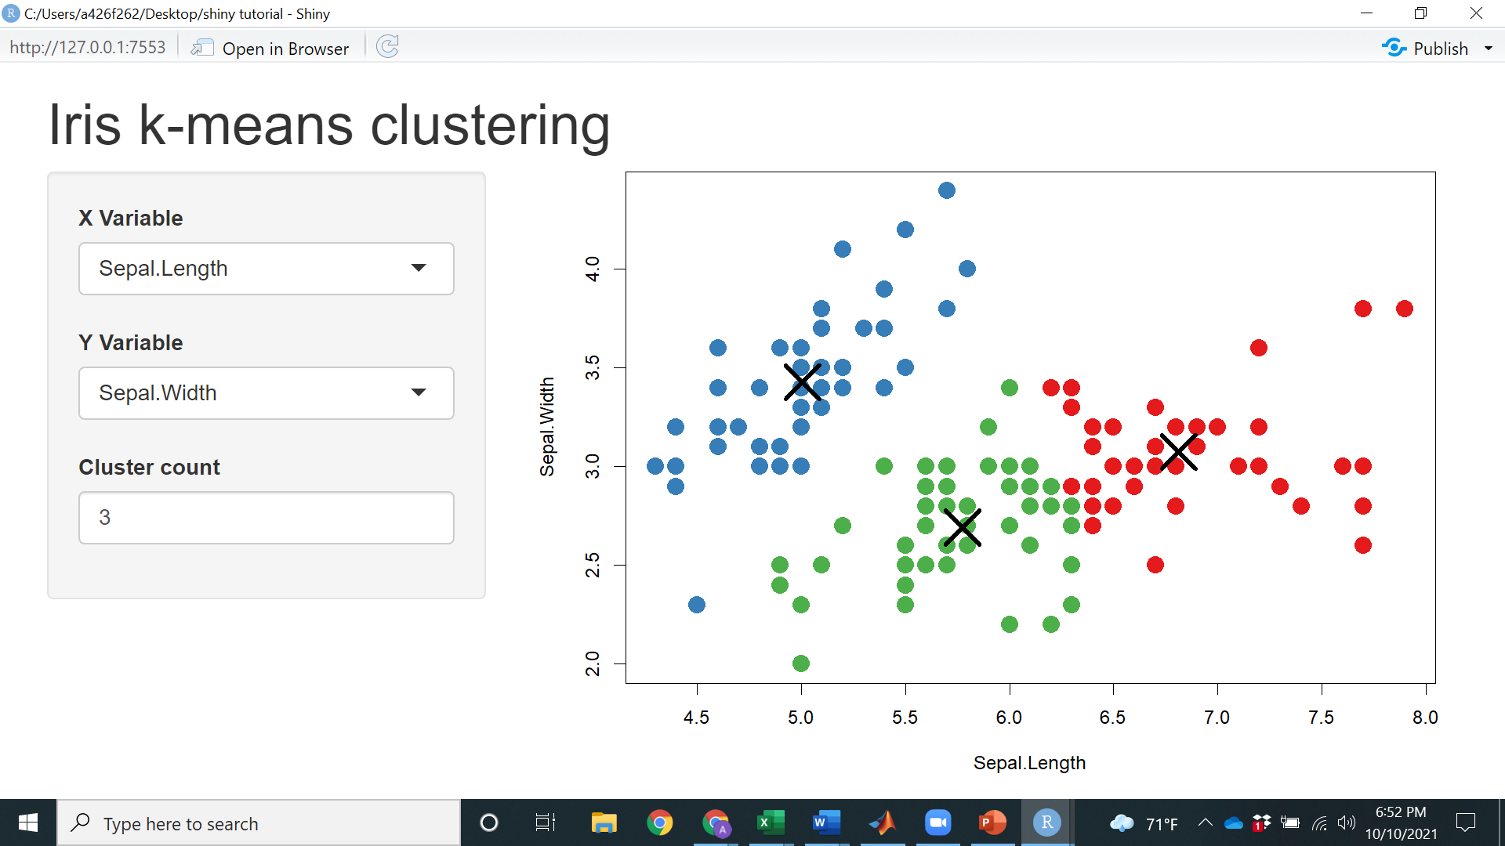
Before getting into it
Shiny applications run in a simple way
This Photo by Unknown Author is licensed under CC BY-SA
Notes:
Now that you’ve seen some of the possibilities when it comes to shiny applications, I’d like to explain a little bit about what goes on under the hood so to speak. First, here is a very simple example of a shiny application dealing with the iris dataset in R.
There is a computer behind the webpage that is shown that reruns the code every time an interactive parameter is changed. Then the computer uploads the new output to the webpage. If you simply run the code and interact with the output then the computer hosting the webpage is your own. Since our code here is so simple, we see the results from changing a parameter almost instantly however if the code is complex enough or you aren’t running it on a very powerful computer, it may take longer to update.
-Usually this isn’t a problem since most published applications are run on a server that is hosted by Rstudio. This will also allow others to access your application online.

Slide 4


Two major Components of a shiny app
This Photo by Unknown Author is licensed under CC BY-SA
Notes:
There are two major components when designing a shiny application.
-In order to effectively display your information, you need to become somewhat of a user interface designer. Even if you are presenting profound information, it wont matter if users cant figure out how to use your application or if they don’t understand what is being displayed. Both of these things have to do with the user interface design of the application that you build. For our simple example here, there isn’t much to consider. So long as the graph is colored appropriately and your axes are labelled, you can be fairly confident that a user will be able to use and interpret your application, but for some more complex applications, figuring out how to present your information and programming it into the ui can be a time-intensive process.
-along with that comes the second major component, the server instructions. These tell the computer what it needs to do when a user changes an interactive section of the ui. Usually this will be taking the new value that the user input on the ui and inputting that into the application code, rerunning it, and updating the user interface accordingly.
GO THROUGH CODE ON IRIS EXAMPLE

Slide 5
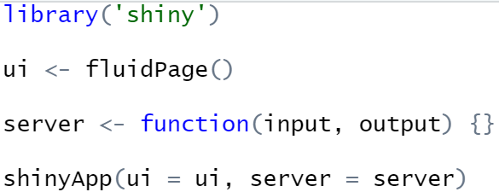
A useful tool
USE THIS TEMPLATE EVERY TIME YOU MAKE A SHINY APPLICATION:
Notes:
Here is a very basic template that will be used to get every shiny application that you make started. It’s 3 main lines, one for initiating the user interface (ui), one for the server instructions (server), and one for combining those two things into the full shiny application.
RUN IN R
Notice that until we close the application, our r session will continue to be used to maintain the application. If we’d like to add things to this application, we need to close it first. Let’s do the canonical “Hello world”

Slide 6
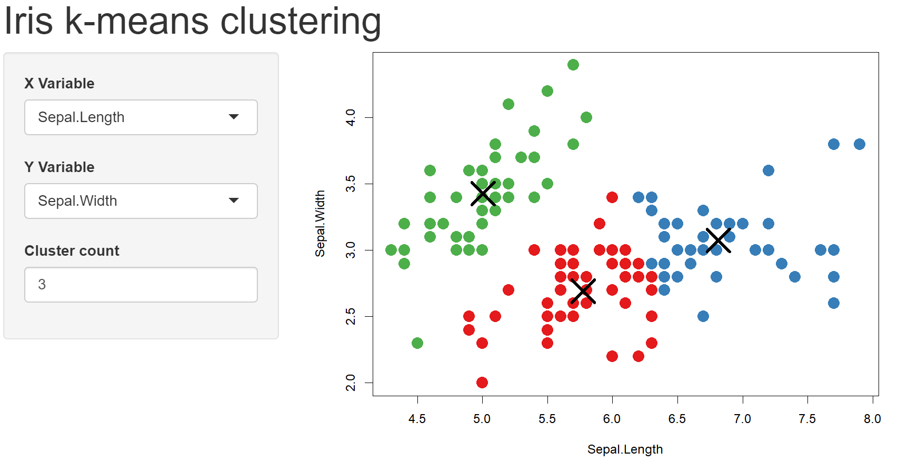
When building your application
Think in terms of inputs and outputs
Notes:
Now to fill out your application and make things more interesting, it’s important that you start thinking about inputs and outputs
-inputs are those things that users will be able to change. In this example we have two dropdown menus that the user can select attributes from as well as a counter determining the number of clusters used in our clustering algorithm.
- Outputs are what the user sees. These can be plots, tables, charts, text, or several other things. They will be what responds when the user changes an input. And in order to edit these things, it’s very simple. You just need to change the ui portion of the template

Slide 7
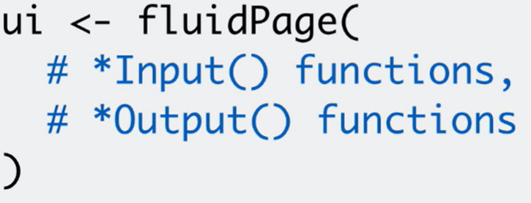
Inputs and outputs
Notes:
So in order to add more inputs and outputs, you simply add input and output functions in the ui section of the code. I’ll cover some common and very useful input and output functions that you may use. These functions are the basis of the user interface, so even if you choose not to do any further editing, the basic results given from these may suffice if your goal is simply visualization and not publishing.

Slide 8
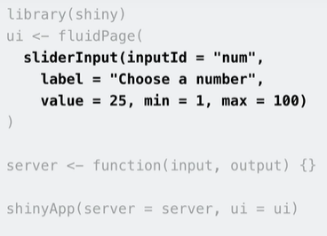
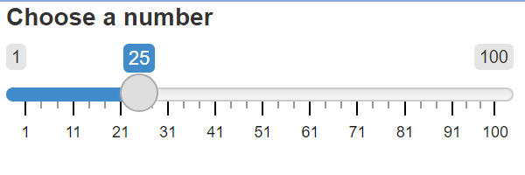
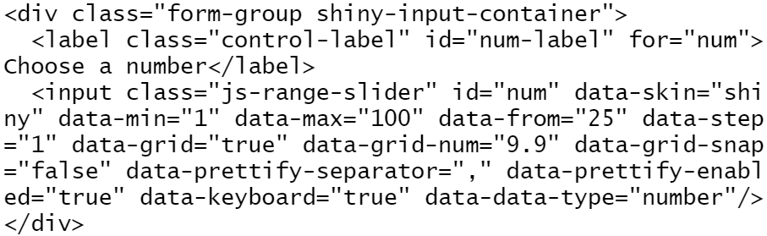
Input functions
Notes:
Going into more detail, here is a very basic function to create a slider.
-if you copy/paste the code in black and enter it into the console, you will get back the html code that is used to generat
-this output. I can’t use the slider since I’ve only pasted the results of the given code here, but you can see that it gives you a relatively decent looking slider with just a single function.

Slide 9
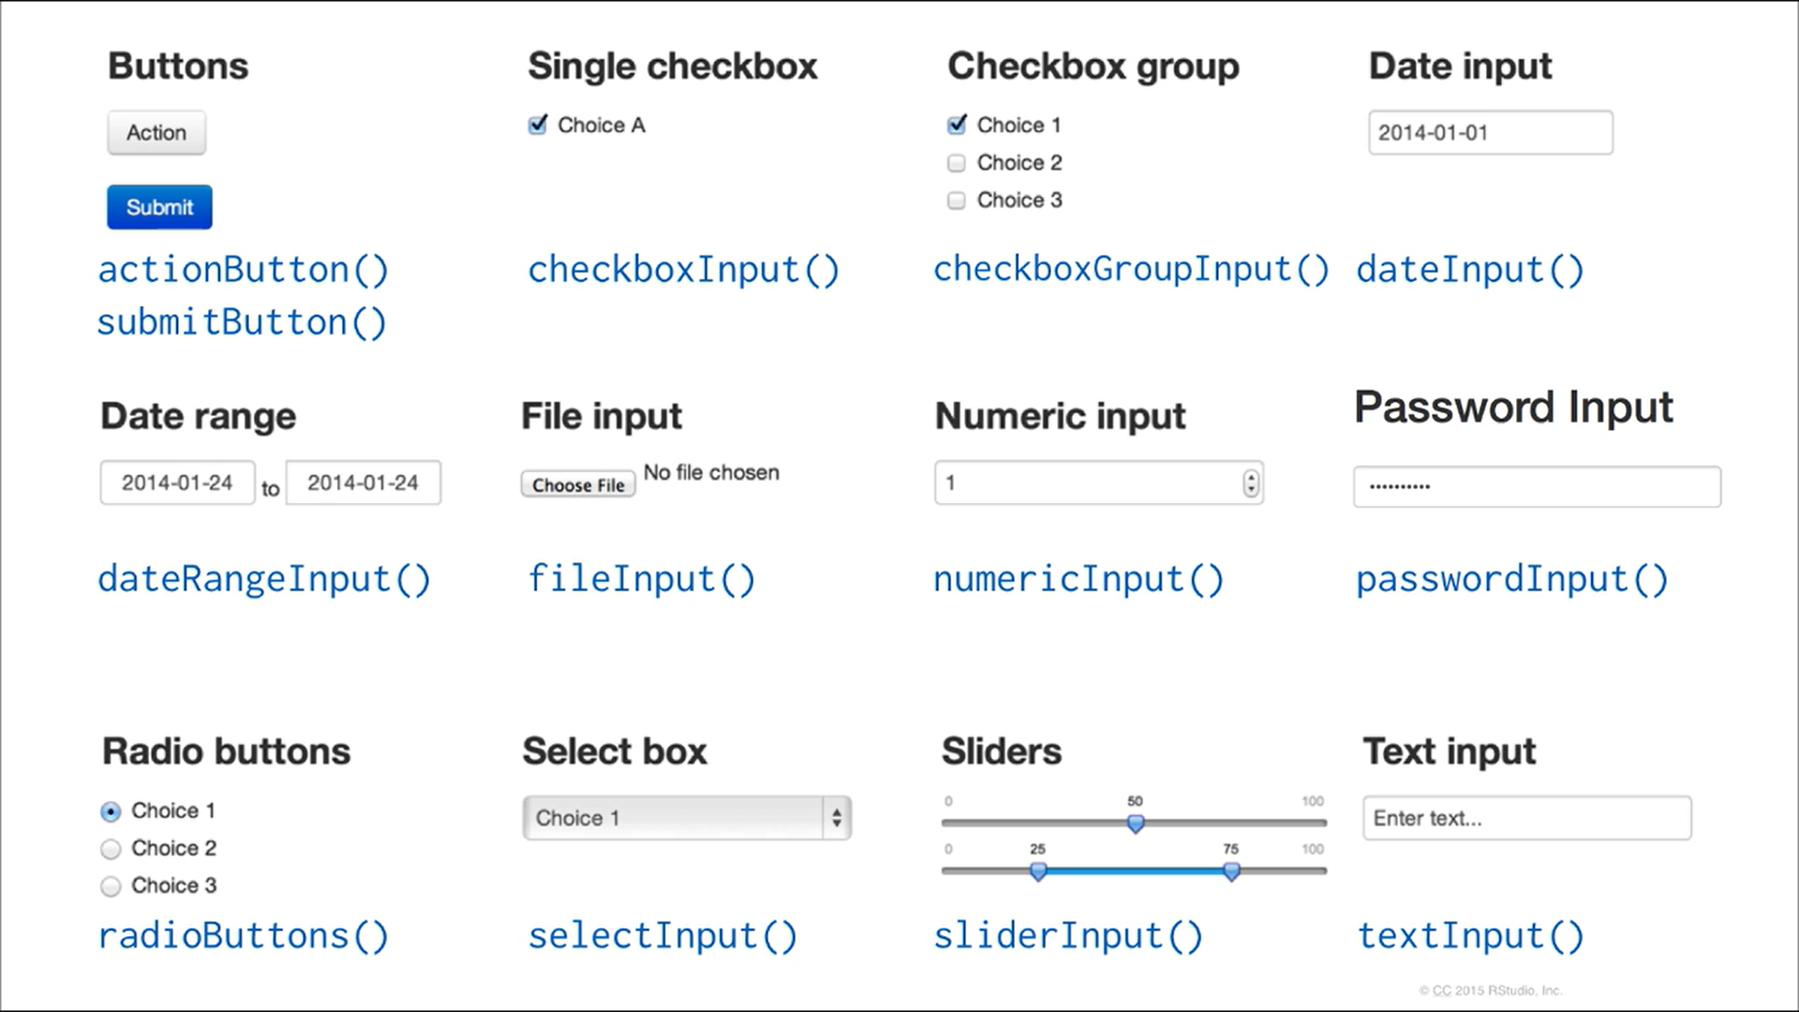
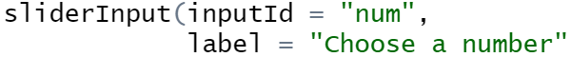
Input functions
Notes:
Here are most of the input functions that you’ll likely use if you ever build a shiny application. As you can see, there is a wide variety of options when constructing your application, so keep that in mind when deciding how you want to disseminate information on your application. Basically, any interaction that a user can have on a website is available in one of these functions.
-now, all input functions have some basic pieces that will need to be decided upon. The first is the inputId, pay careful attention to the casing of your functions as this is often the difference between your program working and it throwing an error message. The input id will be used later in the output functions as well as when you’re telling the server what to do with the inputs and outputs that you define here.
-The second thing that is included in every input function is the label. This will be the title of the component that you’re defining, in our case, it’s telling the user to choose an input value using the slider that we made. If you don’t want your component to have a label, just use two quotation marks and nothing will appear above the slider in this instance. Lastly, there will be additional arguments that are dependent on the input function being used. For the slider example, we had to input the minimum and maximum values of the slider as well as the starting value of the slider. If you’d like a list of all of the possible arguments for an input function, simply type ? And then the name of the function into the console and that will bring up the help page for that function with all additional information.

Slide 10
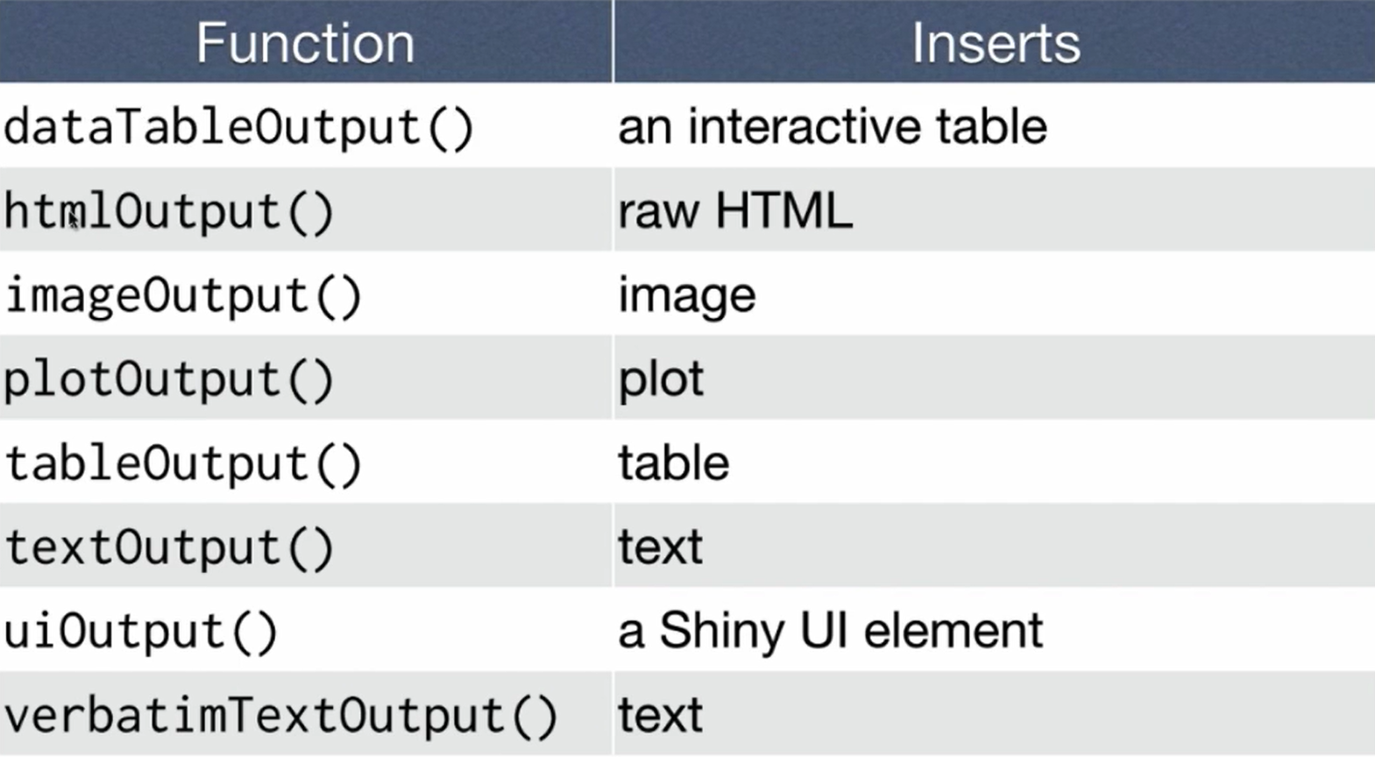
Output functions
Syntax
plotOutput(outputId = “hist”)
Notes:
Now let’s go into output functions. Here is a list of all output functions that are very useful for displaying all kinds of data.
-the syntax for output functions is relatively similar to that of input functions.
-You start off with the type of output that you want to display, in this case, it’s a plot.
-Then you define the output id and similar to the input id, it will be used later in the code to identify this output. Generally, you want each input and output object to have unique names, this will help you avoid errors down the road.

Slide 11
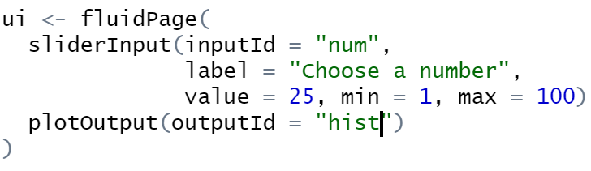
Output functions
Notes:
Now, if we add this plot to the ui element of our code and run everything, we seemingly get the exact same output as when we only defined the slider. In truth, R is setting aside space on the application page for a plot, even though it has no idea what kind of plot you want it to construct. You need to tell the server how to construct this plot, which is what we’ll go over next. But first, let’s do a quick recap of everything that I’ve covered so far

Slide 12
recap
Begin each application with the template
Add elements as arguments to the fluidPage() function
You can add interactive inputs via input functions
Display your results using output functions
Use the server function to tell the computer what to display and how to display it
Notes:
-begin each application with the template that I displayed earlier
-add elements to the application via the fluidpage/ui function
-interactive elements can be incorporated using the input functions
-display your results using output functions
-use the server function to assemble your inputs and outputs any way you want

Slide 13
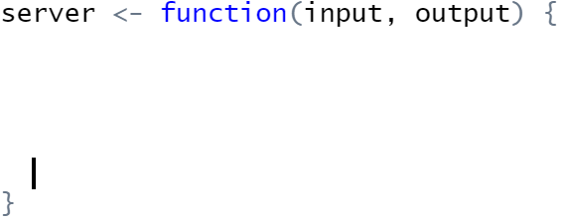
Server instructions
We need to tell the server how to assemble our inputs and outputs
Rule 1: save every output as output$
Notes:
We need to tell the server how to assemble our inputs and outputs. This is done using the server function. As it’s given in the template file, there are no instructions so far. There are three main rules that should be followed when creating the server instructions.
-first, you need to save every output as output$something depending on what the output is.
-This bit of code would save the hist element that we defined earlier to the output list and we can define what exactly hist is using code after the arrow shown. Output here is just an argument used in the server function. Bot input and output must be used as arguments in your server function and they will simply be list-like objects.
-Again the element hist is used because it will be used to define the hist object that we named in the ui section of the code and it will be what is placed in the plotting function. Be sure to use the correct name (outputid) that you want to correspond with a particular plot in order to get things to display correctly.

Slide 14
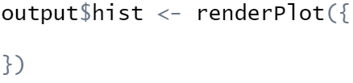
Server instructions
We need to tell the server how to assemble our inputs and outputs
Rule 2: use a render function
Notes:
-The second rule when defining your server instructions is to use a
-render function when creating an output.

Slide 15
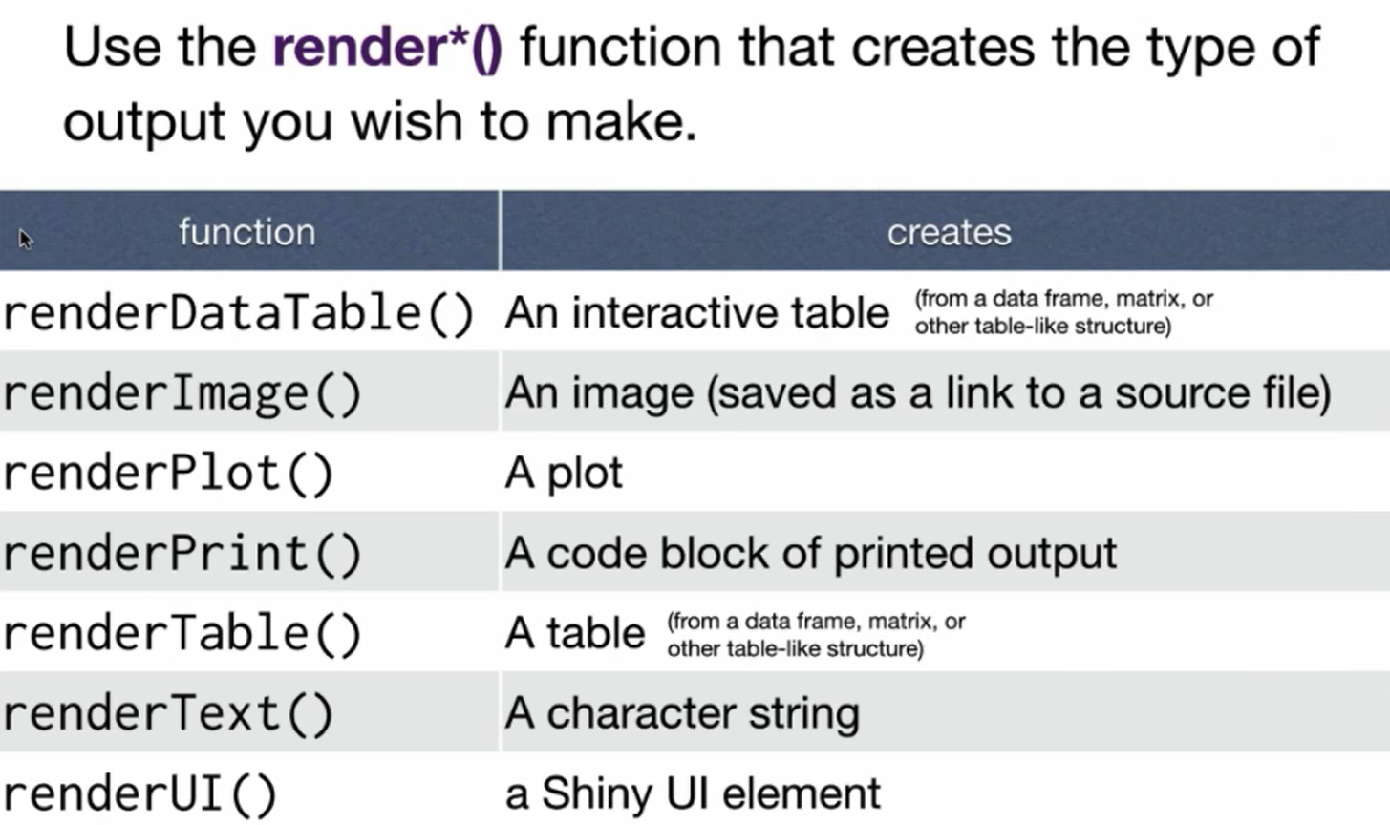
Server instructions
We need to tell the server how to assemble our inputs and outputs
Notes:
Shiny provides a third set of functions called render functions. Render functions work with output functions to create the html code needed to construct your plot or other objects. Just like output functions, there are different render functions to render different types of outputs. There are several types of render functions such as render image, render plot, render table, and in many cases there will be a direct analog between the output function and the render function needed to create it.

Slide 16
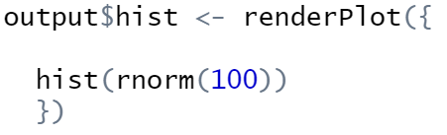
Render functions
Continuing to build off of the toy example:
Notes:
All that we’ll be doing here is plotting a histogram of 100 random normal values. The function hist creates a histogram of whatever data you provide and rnorm(100) draws 100 random values from a normal distribution.
-the section portion of a render function tells you the type of object that will be rendered with that function. We’d like a histogram, so we use renderPlot.
-within the curly brackets, we place the code needed to generate the plot that we want. This is where we’d put, for example, the code pertaining to the generation of plots for an SIR model that we’re testing. The curly brackets allow you to place as many lines of code as needed to generate the output that you’re building, so the code doesn’t need to be on the same line as where you open the render function, just make sure to keep track of which brackets correspond to which functions as it can get complex with multiple render functions.
-for example, we can have this simple bit of code to generate that histogram, or
We can spend some time developing it a bit further by adding things like a title to our plot and so forth. Again you can put as many lines of code here as you’d like and this is where you can start developing some more advanced plots and applications depending on the code that you put here.

Slide 17
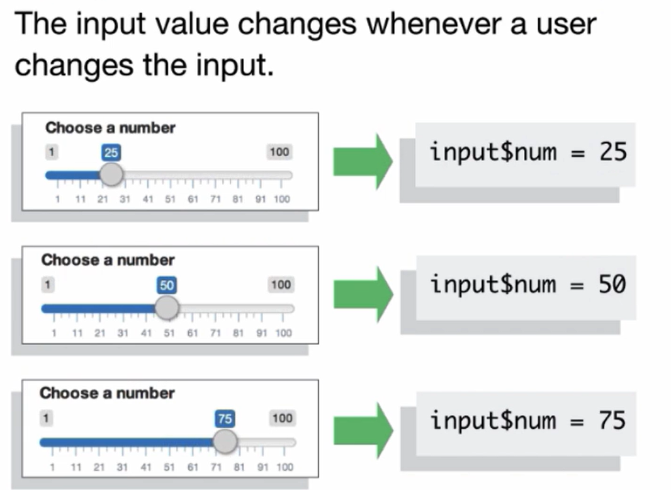
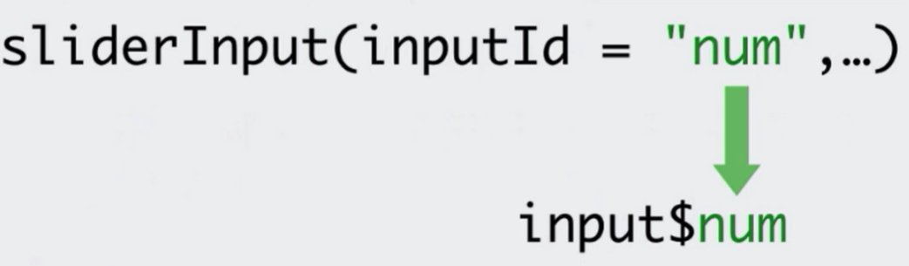
Rule 3
Save every input as input$
Notes:
In order to access our input values to make the outputs interactive, we need to call them in the server function and place them wherever they’re needed for a particular output. We use similar syntax compared to when calling output functions. Input values are the values of the drop-down menus, sliders, dates, etc that you put into your shiny application. Earlier we made a slider input and called it num. Inside fo our server function, we can access the value of that input by using input$num.
-input values are special because they will change depending on the input provided. So for the slider case, the value will change depending on the value input by the user. In this case, the value of num will change depending on if we have the slider set to 25, 50 or 75.

Slide 18
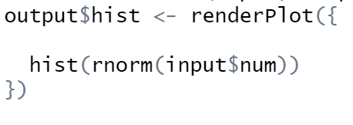
Rule 3
Save every input as input$
Notes:
Now in order to make an output interactive, you simply place the input value whenever it is needed in the render function. In our toy example, we can place the input$num value where we previously had 100. This will allow us to change the quantity of random numbers pulled using the function when we change the slider value.

Slide 19
The three rules
Rule 1: Have every output as output$
Rule 2: Use a render function
Rule 3: Have every input as input$
Reactivity automatically follows if you use these three rules
Notes:
To recap everything that we learned about inputting server instructions, Following these three rules will allow your application to automatically become reactive.
-Make sure to have every ouput saved as output$,
-use a render function,
-and have every input as input$.
-Then R will take care of the reactivity of your application without you having to do anything else.
For our example, this will link the output plot with the input value num and every time the value of num is changed, it will immediately update the corresponding plot. When the value of num is changed, it will ping the render function to let it know that the plot is out of date and things will be updated.
RUN THE EXAMPLE IN R

Slide 20


Sharing your shiny application
This Photo by Unknown Author is licensed under CC BY
Notes:
We have covered how to create the most basic of shiny applications, and we’ll go into some more detail about creating more advanced applications next week, but for now I’d like to go into some more detail about how to share your application over the cloud so that others can visit and explore it, which is the main point of creating a shiny application. We saw earlier that a lot of what we do in R translates into html code using our various functions and this is what allows us to easily create a webpage for our application.

Slide 21
Running an Application on the cloud
This Photo by Unknown Author is licensed under CC BY-SA
This Photo by Unknown Author is licensed under CC BY-SA
Notes:
We covered this image earlier. A shiny application requires an R session behind the scenes so that it can update outputs when inputs change. As I mentioned previously, if you simply run your application on your computer, then the r session open on your computer is used to maintain the application that you just launched and the application can only be accessed locally.
-we can get around this by using a server to host our application over the cloud which will allow others to easily access it. There are lots of options when it comes to finding a server to host your application, but regardless of which you choose, your code will need to be saved in a standardized way so that any server that you choose can access the file and run it.

Slide 22
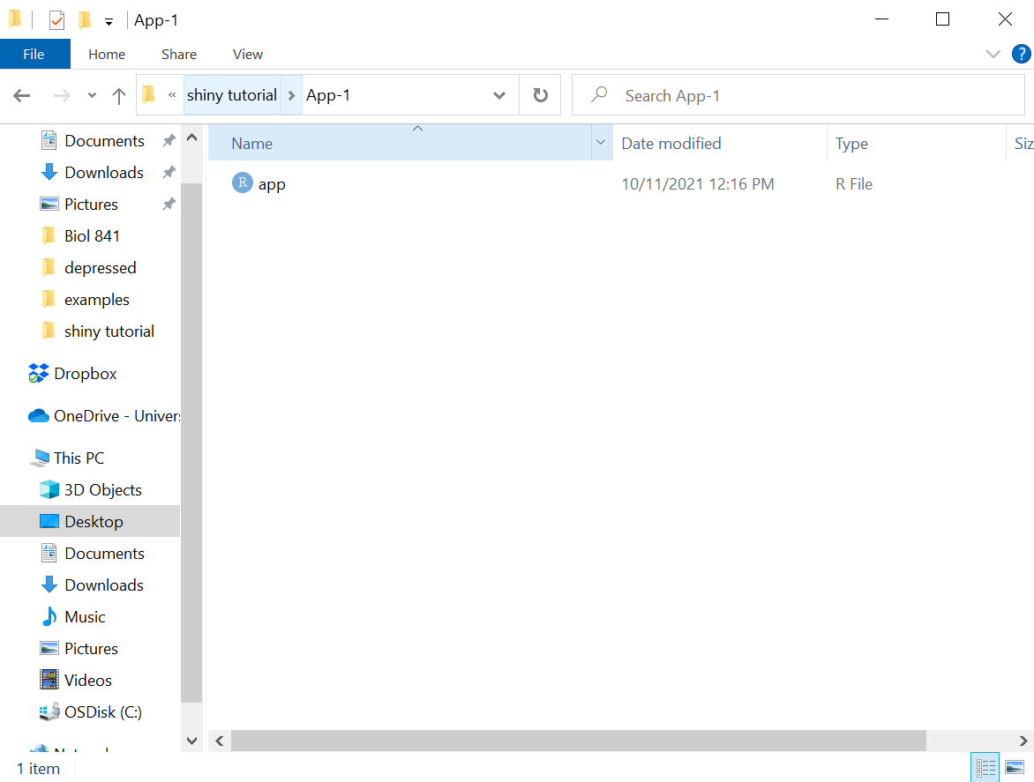
Saving your application
The name of the file that ends with the call shinyApp() needs to be saved as app.R in its own directory with any other necessary files
Notes:
The name of the file that ends with the call shinyApp() needs to be saved as app.R in its own directory with any other necessary files. These can include datasets, images, or any other file that is called within your application.
-here is how we would save our example from earlier. You need to save the application with this name exactly as it is the identifier for the server so that it knows which of the files in the directory needs to be run to create the application

Slide 23
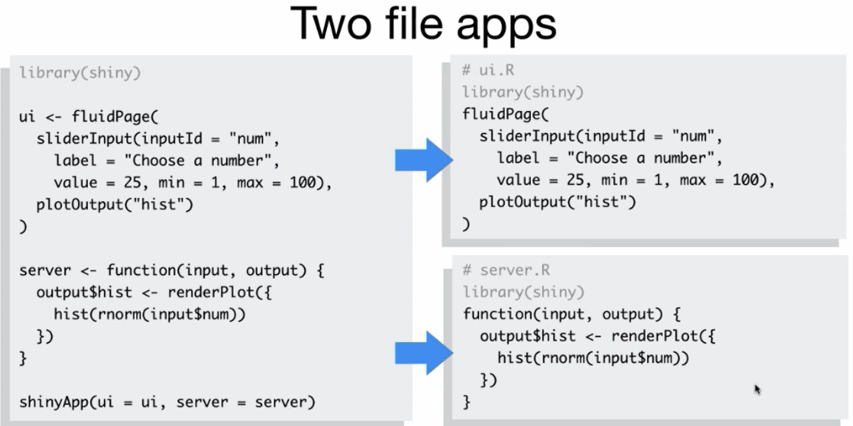
Another option
Notes:
You can optionally save your shiny application as two separate files. This is simple to do and may be useful in some particular cases. If you have an extremely large and complicated application, it may be helpful to you to split it up into these two components. You would name these the commented names given above each section and in this case you don’t need to use shinyApp() to create the application. Similar to the previous option, you’ll want to save these two files in their own directory along with any other files that are needed to run the application.

Slide 24
Easiest server option
A server maintained by Rstudio: Shinyapps.io
Free
Easy to use
Secure
Scalable
This Photo by Unknown Author is licensed under CC BY-SA
This Photo by Unknown Author is licensed under CC BY-SA
Notes:
The easiest server option currently is shinyapps.io. This is a server maintained by r studio and there are several perks that make it one of the best options out there. It’s free, easy to use, secure, and scalable which means that the server will automatically account for multiple users using your application at the same time and it will create additional r sessions for each user.
All that you need to do to get your application from your computer onto the shinyapps.io servers is to create an account and follow the instructions given to get your application uploaded to the website.
GO TO THE WEBSITE AND WALKTHROGH IT BRIEFLY

Slide 25
Recap on sharing your application
Be sure to save your application in its own directory as app.R, or ui.R and server.R if you want two separate components to your application
Use shinyapps.io to publish your application online for others to see

Slide 26
Content covered so far
Build an app
How to create reactive applications using input and output functions
Sharing your application
Notes:
So far we have learned
-how to build an application
-how to create reactive applications using input and output functions
-how to share your application using shinyapps.io so that others can utilize it
Next week, we’ll create some more complex examples, I’m not sure if that will take the entire time though

